Slide 1
Capstone Project –
The Battle of Neighborhoods Finding a Better Place in Scarborough, Toronto
A Presentation by Ananya

Slide 2

GOOOAL!
Lots of people are migrating to various states of Canada and need lots of research for good housing prices and reputed schools for their children. This project is for those people who are looking for better neighborhoods. For ease of accessing to Cafe, School, Super market, medical shops, grocery shops, mall, theatre, hospital, like minded people, etc.

Slide 3


1. Intro
DATA COLLECTION Highlight what’s new, unusual, or surprising.
METHODOLOGY A little behind the scenes
RESULTS Final outcome

Slide 4
We will use Scarborough data from Toronto Dataset which we scrapped from wikipedia . Dataset consisting of latitude and longitude, Postal Code of the neighborhood.
Data Link: https://en.wikipedia.org/wiki/List_of_postal_codes_of_Canada:_M

Slide 5
Foursquare API Data:
We will need data about different venues in different neighborhoods of the specific borough - Scarborough. In order to gain that information we will use "Foursquare" locationa information. Foursquare is a location data provider with information about all manner of venues and events within an area of interest. Such information includes venue names, locations, menus and even photos. As such, the foursquare location platform will be used as the sole data source since all the stated required information can be obtained through the API.

Slide 6
The data retrieved from Foursquare contained information of venues within a specified distance of the longitude and latitude of the postcodes. The information obtained per venue as follows:
1. Neighborhood
2. Neighborhood Latitude
3. Neighborhood Longitude
4. Venue
5. Name of the venue e.g. the name of a store or restaurant
6. Venue Latitude
7. Venue Longitude
8. Venue Category

Slide 7

Map Marking All Scarborough Neighborhoods

Slide 8
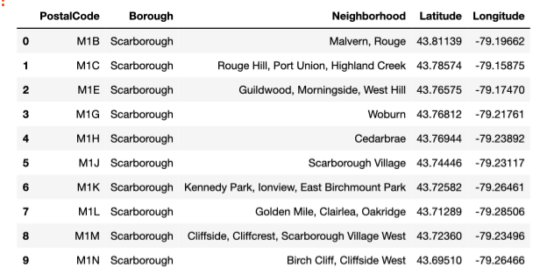
DATASET OF SCARBOROUGH

Slide 9

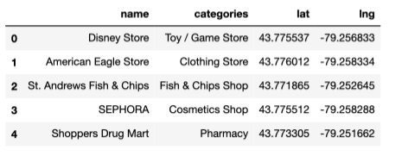
DATASET OBTAINED FROM FOURSQUARE API

Slide 10
3. Methodology Section
Clustering Approach:
To compare the similarities of two cities, we decided to explore neighborhoods, segment them, and group them into clusters to find similar neighborhoods in a big city like Toronto. To be able to do that, we need to cluster data which is a form of unsupervised machine learning: k-means clustering algorithm.

Slide 11
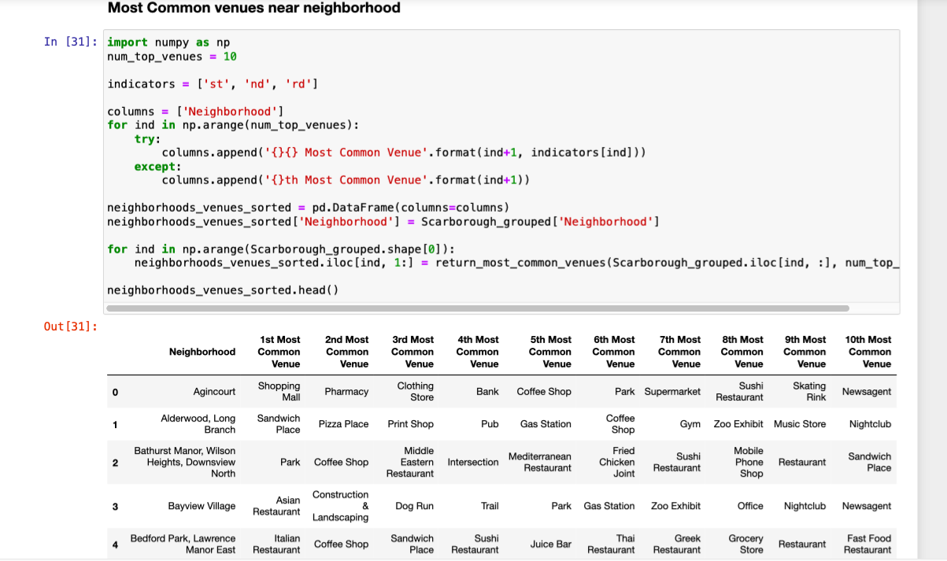
MOST COMMON VENUE IN NEIGHBORHOOD

Slide 12

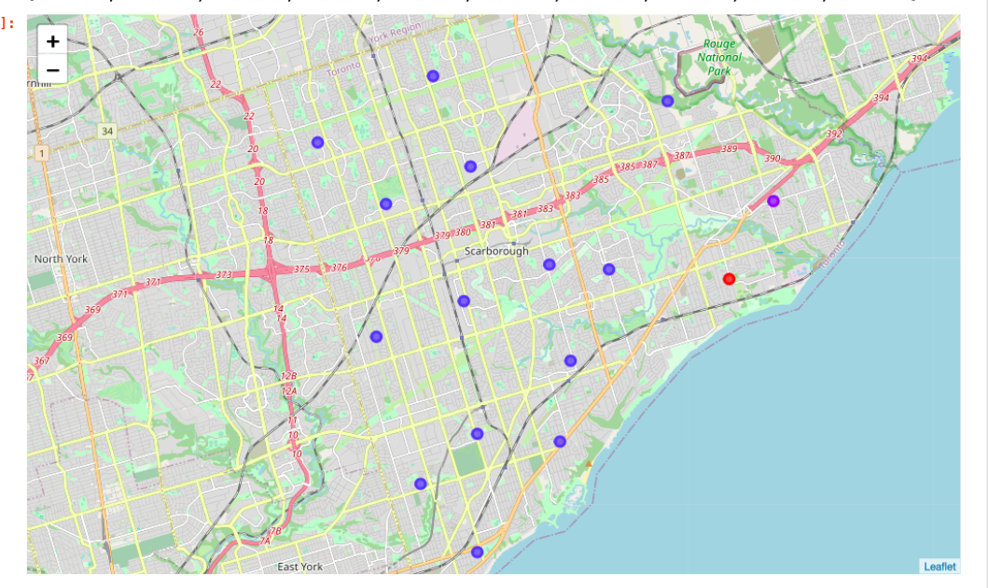
4. Results Section: Map of Clusters in Scarborough

Slide 13
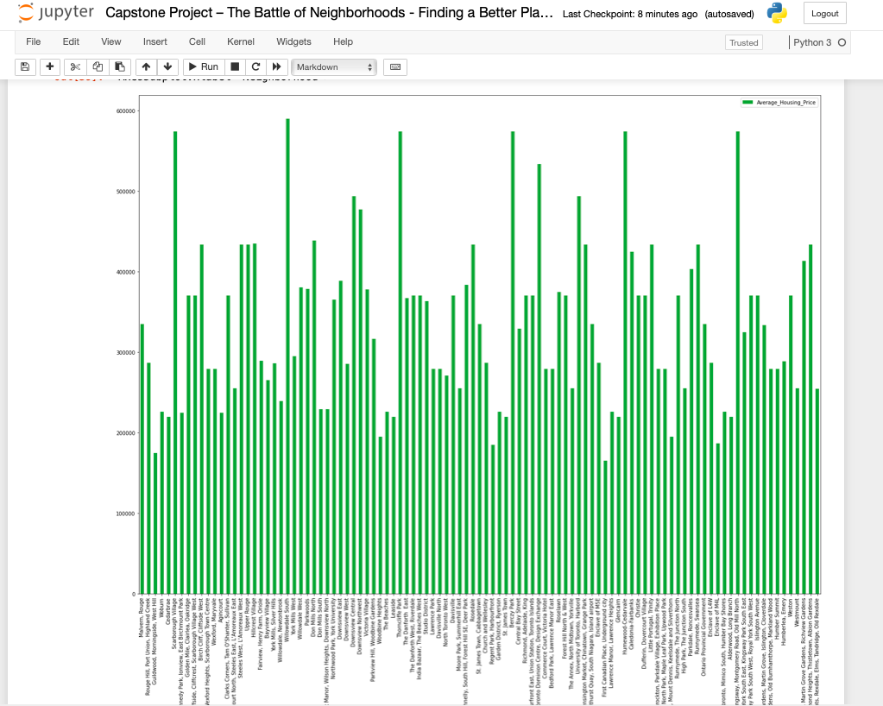
Average Housing Price by Clusters in Scarborough

Slide 14
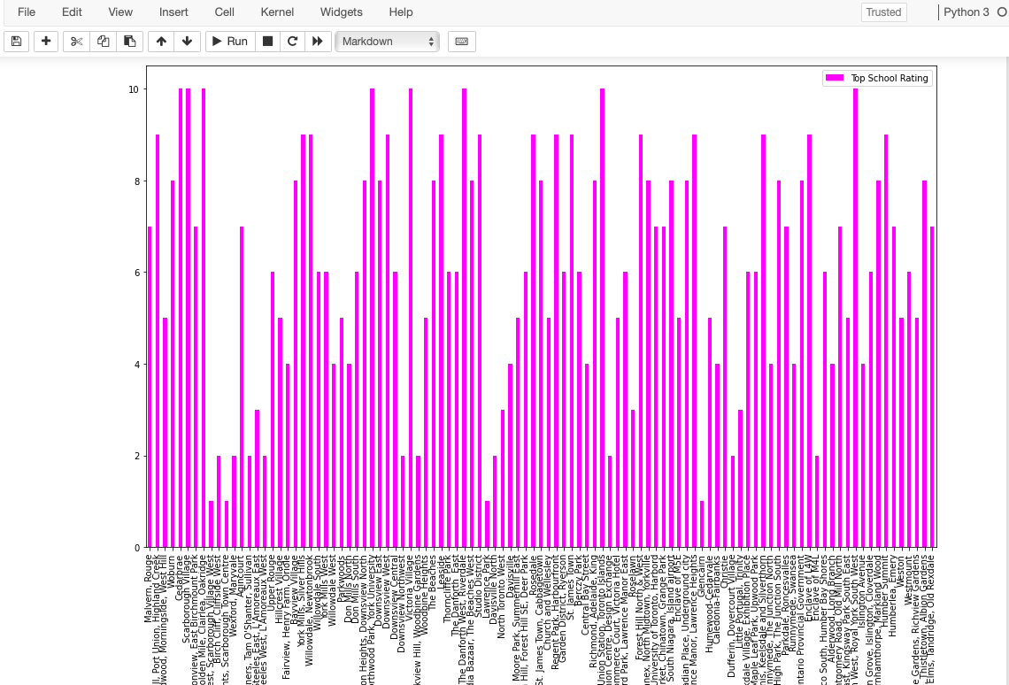
TOP SCHOOL RATING IN THE NEIGHBOURHOOD

Slide 15


6. Conclusion Section
In this project, using k-means cluster algorithm I separated the neighborhood into 10(Ten) different clusters and for 103 different lattitude and logitude from dataset, which have very-similar neighborhoods around them. Using the charts above results presented to a particular neighborhood based on average house prices and school rating have been made.
I feel rewarded with the efforts and believe this course with all the topics covered is well worthy of appreciation. This project has shown me a practical application to resolve a real situation that has impacting personal and financial impact using Data Science tools. The mapping with Folium is a very powerful technique to consolidate information and make the analysis and decision better with confidence.
Source: travel.trade.gov

Slide 16
Future Works:
This project can be continued for making it more precise in terms to find best house in Scarborough. Best means on the basis of all required things(daily needs or things we need to live a better life) around and also in terms of cost effective.

Slide 17
Libraries Which were Used to Develope the Project:
Pandas: For creating and manipulating dataframes.
Folium: Python visualization library would be used to visualize the neighborhoods cluster distribution of using interactive leaflet map.
Scikit Learn: For importing k-means clustering.
JSON: Library to handle JSON files.
XML: To separate data from presentation and XML stores data in plain text format.
Geocoder: To retrieve Location Data.
Beautiful Soup and Requests: To scrap and library to handle http requests.
Matplotlib: Python Plotting Module.

